Slide 1
Evaporation and Evapotranspiration
METR 5633 - Hydrometeorology

Slide 2
What is Evaporation Versus Evapotranspiration?
E = ET = E_{vegetation} + E_{non-vegetated}
E – Total Evaporation (Depth/Time)
ET – Evapotranspiration (Depth/Time)
E_{vegetation} – Transpiration from Vegetation (Depth/Time)
E_{non-vegetated} – Evaporation from “bare” surfaces (Depth/Time)
Transpiration is a critical component of photosynthesis.
”Bare” surfaces include soil, rock, water, etc.
Figure from NASA

Slide 3
Evaporation and the Energy Balance
Vapor Flux
LE = Eρ_{w}L_{v}
LE – Latent Heat Flux (Energy/Time/Area)
E – Total Evaporation (Depth/Time)
ρ_{w} – Density of Water (Mass/Volume)
L_{v} – Latent Heat of Vaporization (Energy)
Energy Flux
Figure from NASA

Slide 4
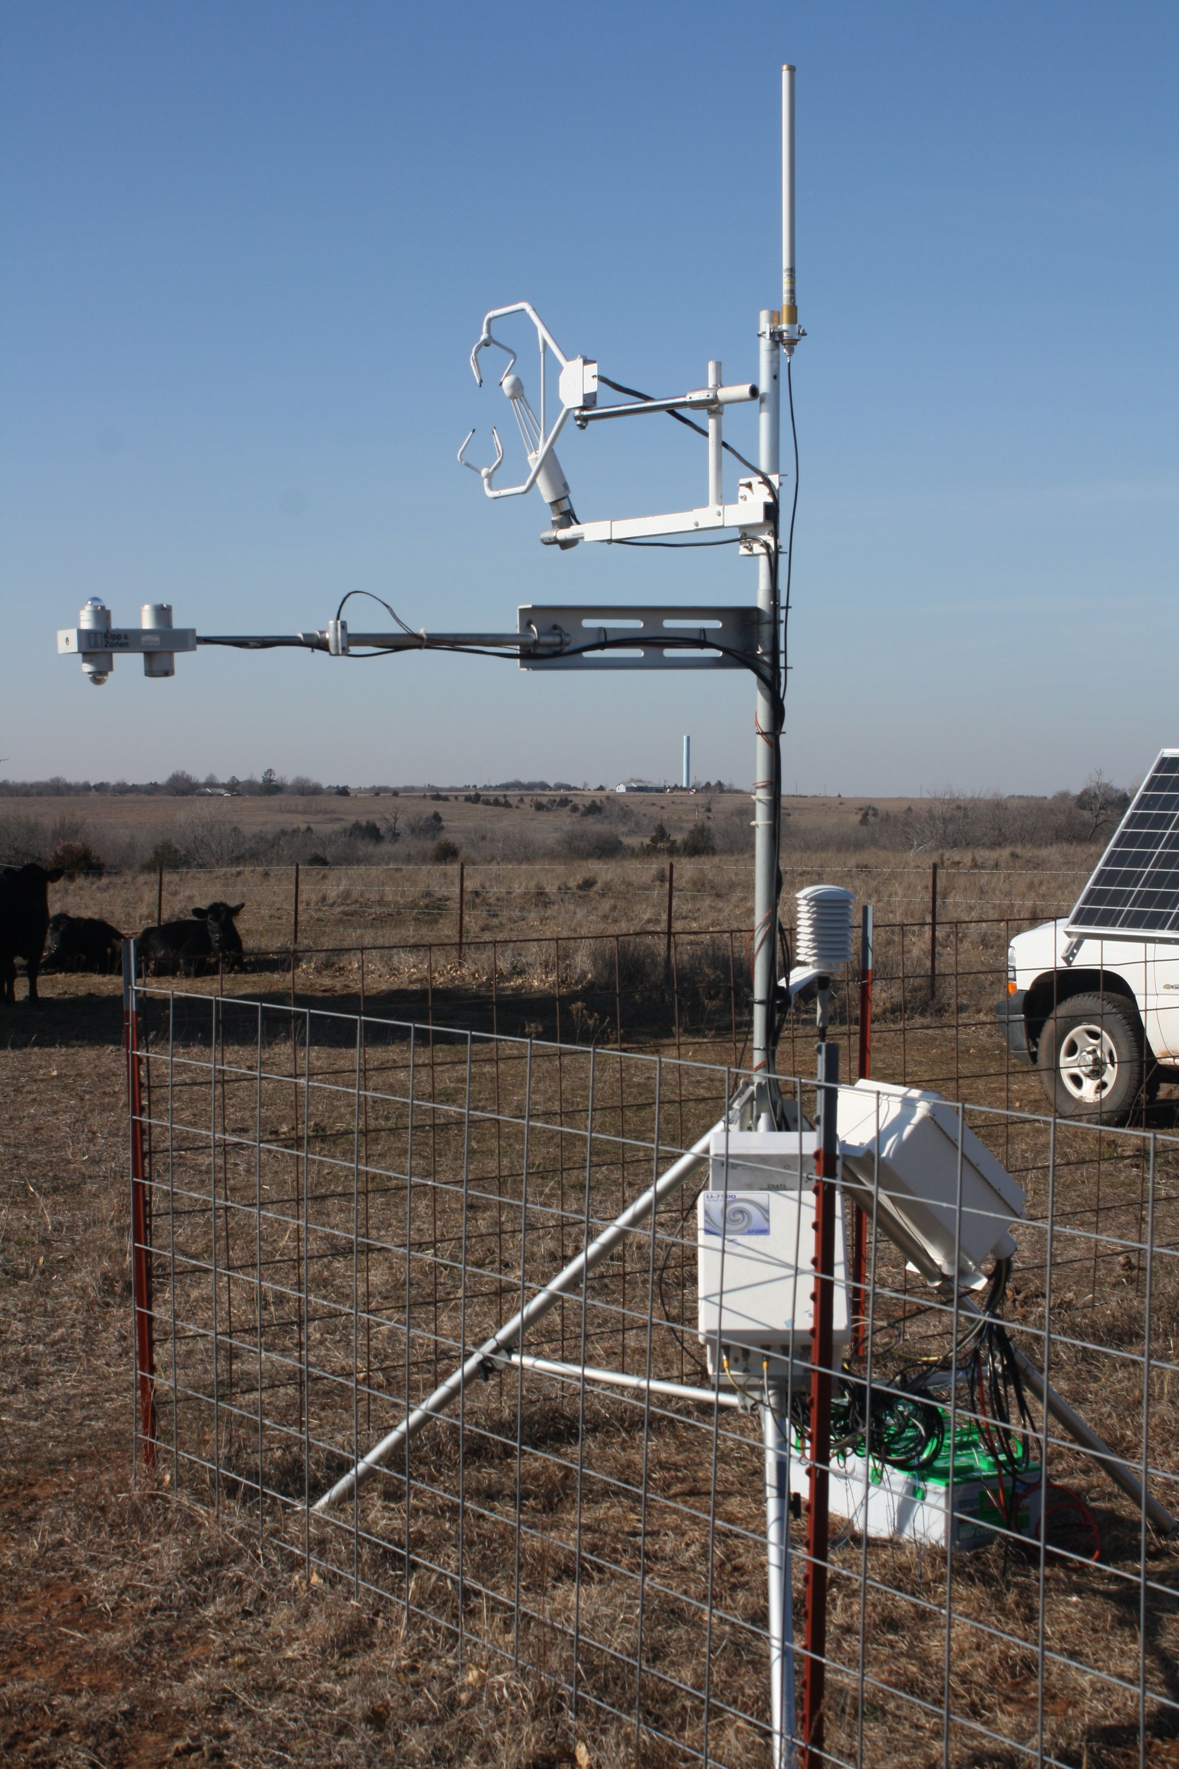
Campbell Scientific CSAT 3 3-D sonic anemometer
Example Energy Balance Flux Tower – Measuring the Surface Energy Budget
Licor 7500 CO₂ and H₂O Open Path System
Vaisala HMP45C air temperature/humidity sensor
CNR1 4-component net radiometer
Apogee Infrared Temperature Sensor
Hydra Probe soil moisture sensor.
REBS soil heat flux plates (3)

Slide 5
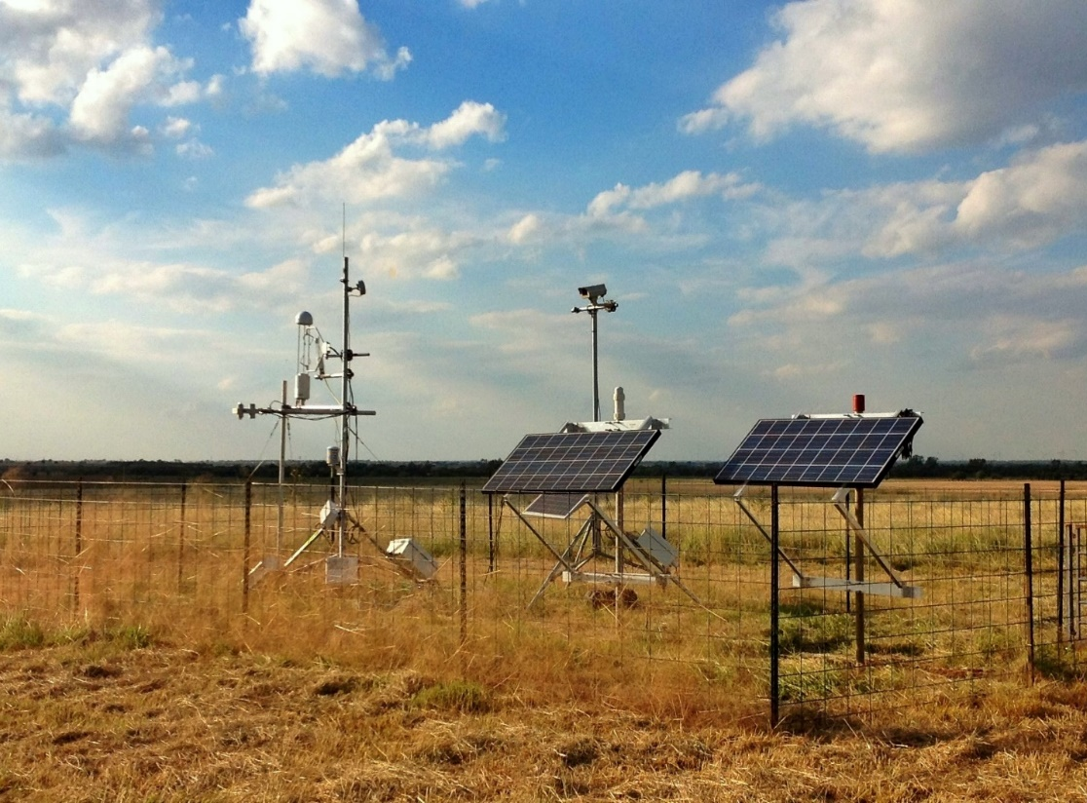
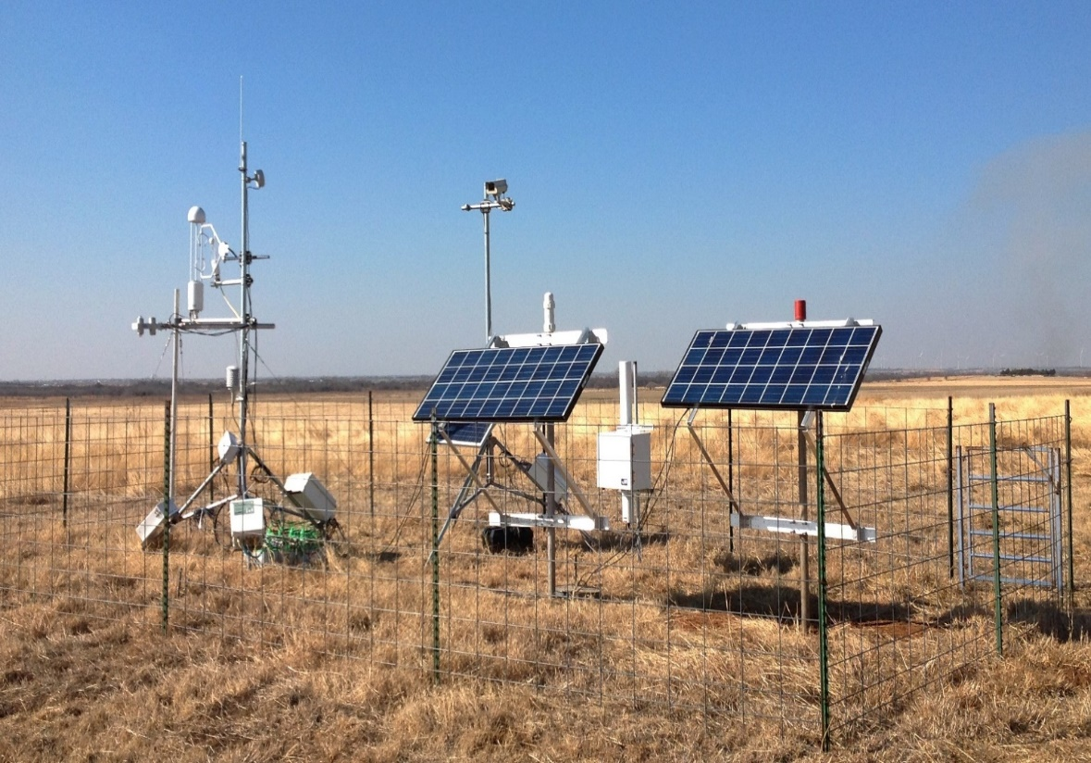
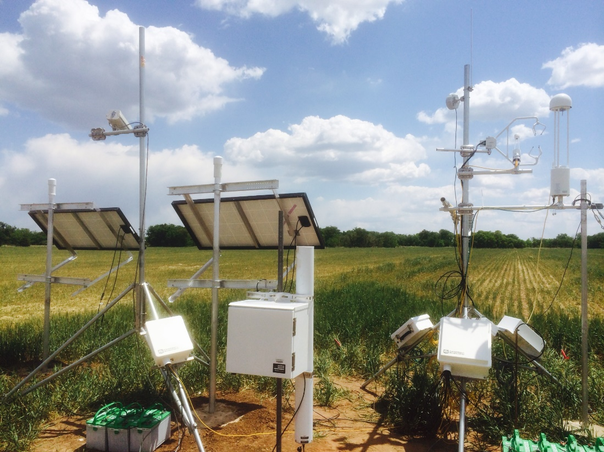
Grassland
Grassland
Cropland

Slide 6
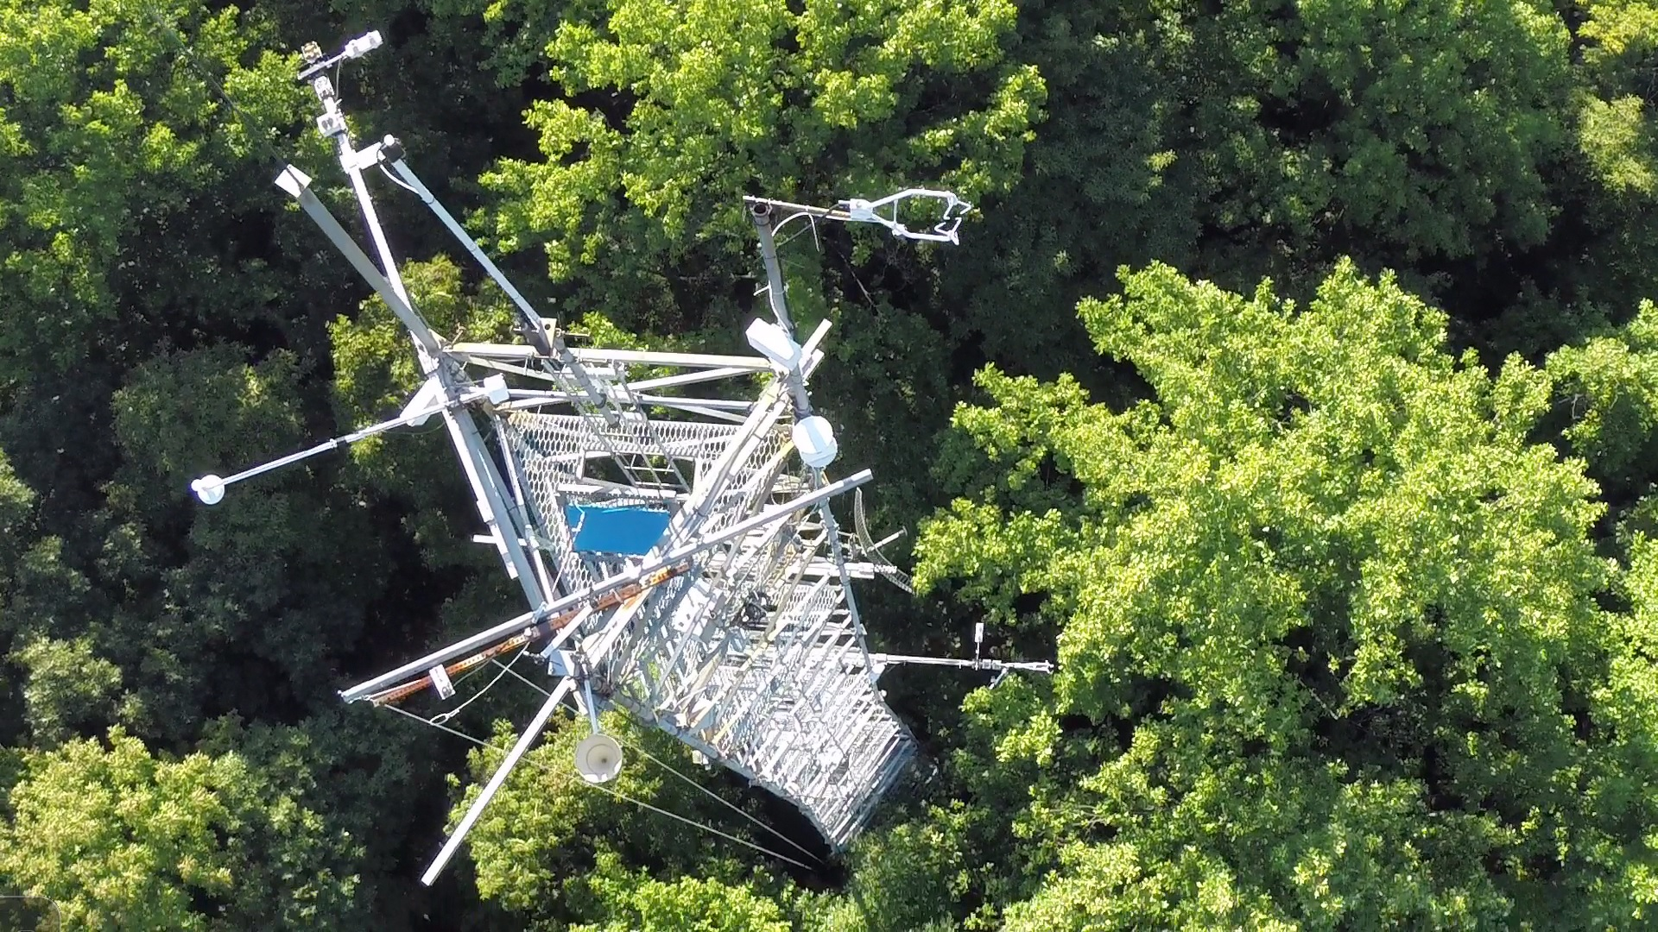
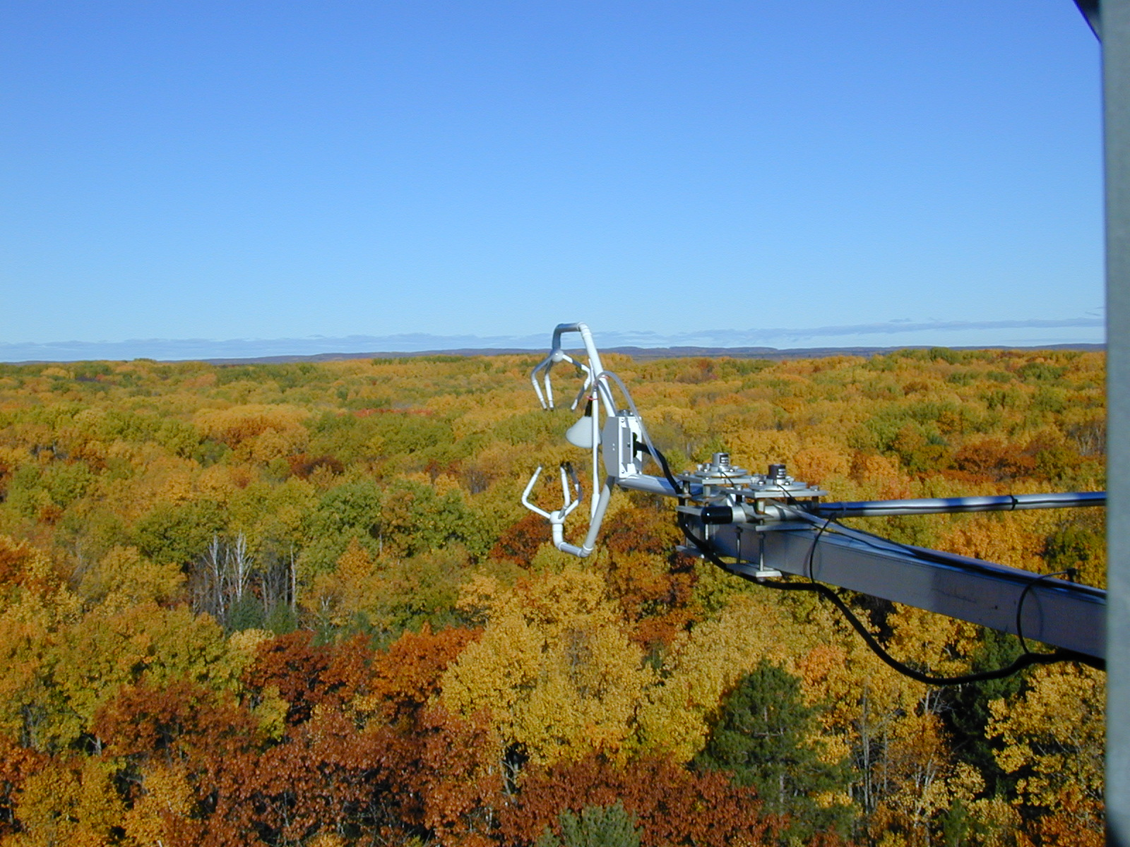
Flux Towers Over Forest Canopies

Slide 7
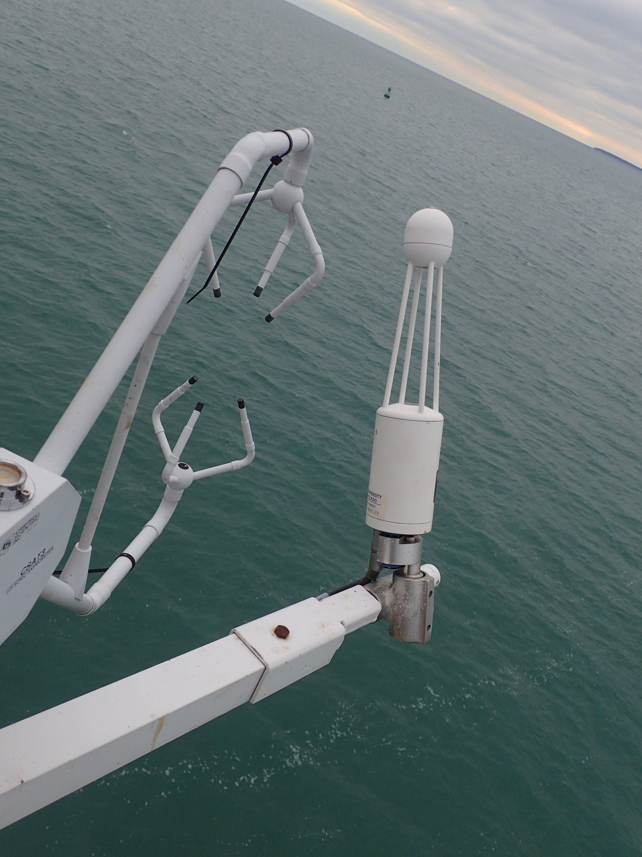
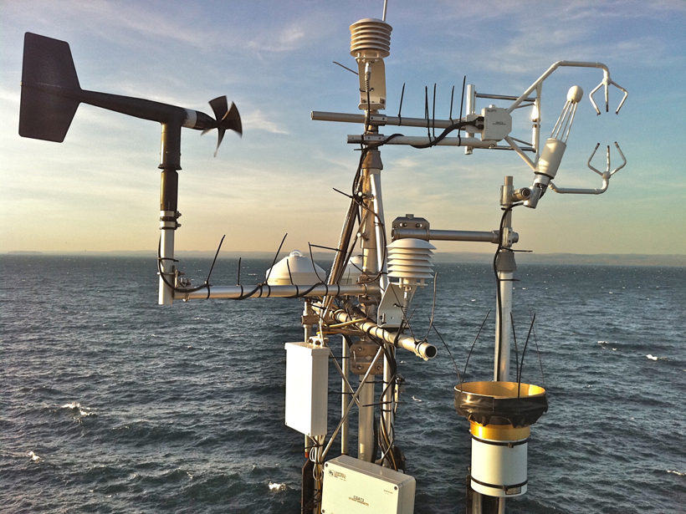
Flux Towers Over Water

Slide 8

The Bowen Ratio
$$β= \frac{SH}{LH}$$
β – Bowen Ratio (Unitless)
SH – Sensible Heat Flux (Energy/Time/Area)
LH – Latent Heat Flux (Energy/Time/Area)
Figure from NASA

Slide 9
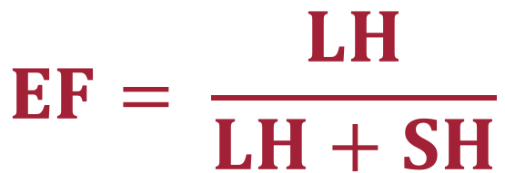
The Evaporative Fraction
$$EF= \frac{LH}{LH+SH}$$
EF – Evaporative Fraction (Unitless)
SH – Sensible Heat Flux (Energy/Time/Area)
LH – Latent Heat Flux (Energy/Time/Area)
Figure from NASA

Slide 10
Limitations of the Surface Energy Budget E/ET Method
Instrumentation is expensive and requires extensive maintenance.
Difficult to measure in areas of complex terrain, complex features (e.g., urban areas), and areas with dynamic/changing surfaces (e.g., water bodies).
Some variables are measured as individual points (e.g., soil moisture) while others are integrated values (e.g., sensible/latent heat fluxes).
Figure from NASA

Slide 11
Questions?

